Slide 1
The Accessible Assessment Enigma
Quality Day 2022
Eric Branscome
Music Department Head

Slide 2
Goals of this session
Identify the pieces of the IER assessment puzzle; and how to know which pieces are yours
Identify the ABCs (and Ds) of Assessment
Prepare you to dive into your own assessment
Question / Answer Session
Brainwash you in the academic rigor of the music curriculum

Slide 3
When I was your age….
My courses
THECB; SACS.COC; QEP; NASM; TEA; etc….
The “Progressive Dinner” Model

Slide 4
Tangent: The Assessment Cycle
Plan
Teach
Evaluate
Reflect
Micro level: In my own classes
Macro Level: As a part of the program and university-wide curriculum

Slide 5
A “SLO” Model for this Session
Writing Student Learning Outcomes
A = Audience (the student will)
B = Behavior (verb – should be assessable or measurable)
C = Condition (how the verb will be fulfilled / what students will use)
D = Degree (the specific target or assessment criteria)
Students will accurately identify minor triads from aural examples in all inversions, nine out of ten times.
Students will perform standard solo repertoire for their instrument or voice type with appropriate technique and musicianship.
(Robert Mager (1962)

Slide 6
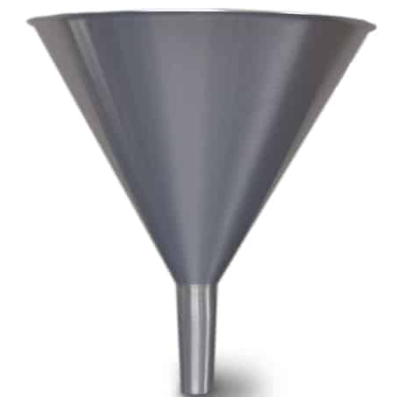
Where (and how) to begin
Writing or revising Student Learning Outcomes (SLO)
Know
Understand
Be able to do
The funnel
Broad to specific
Macro: Curriculum to course
Micro: Course to assignment

Slide 7
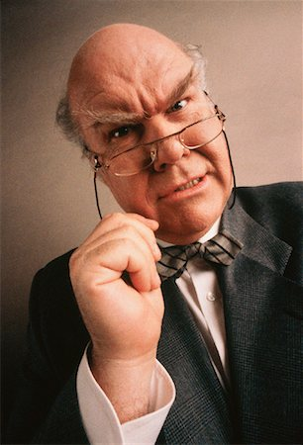
Some examples
What should your students know or be able to do by the end of your class?
Count!
Read!
Think!

Slide 8
Sidebar: A Curriculum Matrix
Model 1: Each class gets its own column
Advantages and Disadvantages

Slide 9
Side Bar: Curriculum Matrix
Model 2: All Classes in one column
Advantages and Disadvantages

Slide 10
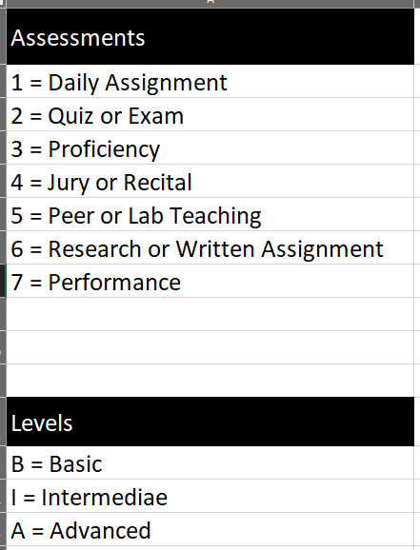

Slide 11
When there are parallel funnels….
SACS.COC
NASM
TEA
… you will need multiple matrices.

Slide 12
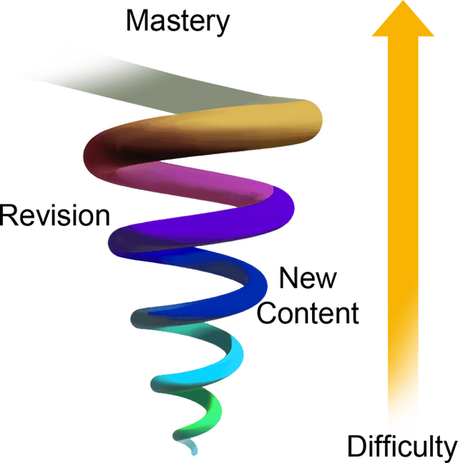
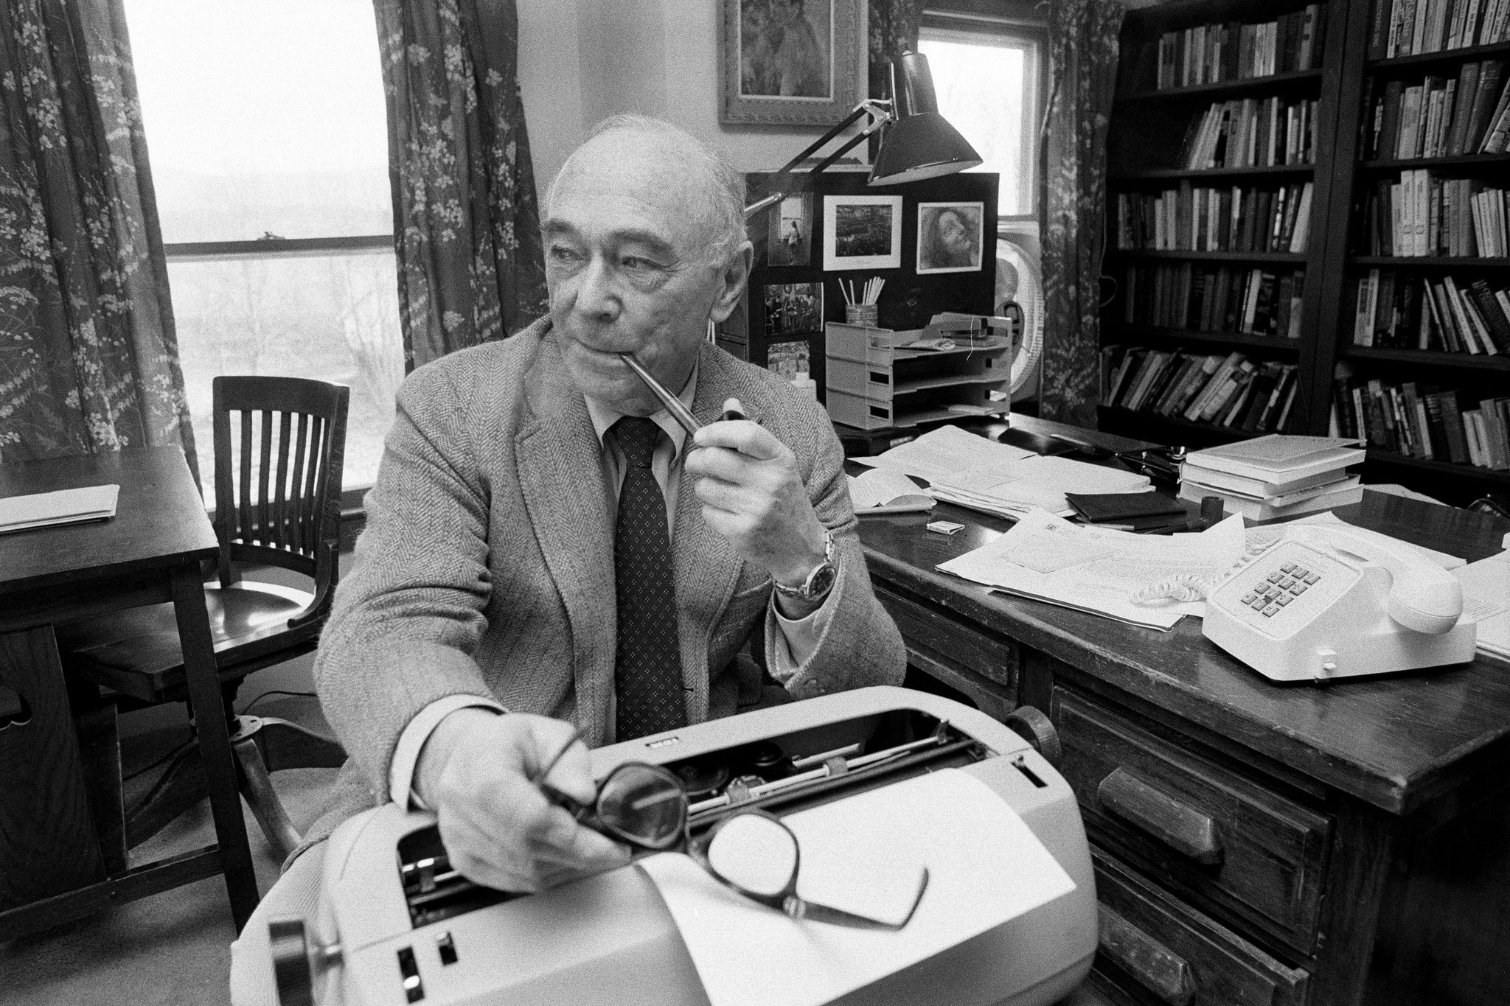
Insights from Educational Psychology
Jerome Bruner
Scaffolding
Sequencing
Spiral Curriculum
Consideration: Where does your class fall in the context of the complete curriculum?

Slide 13
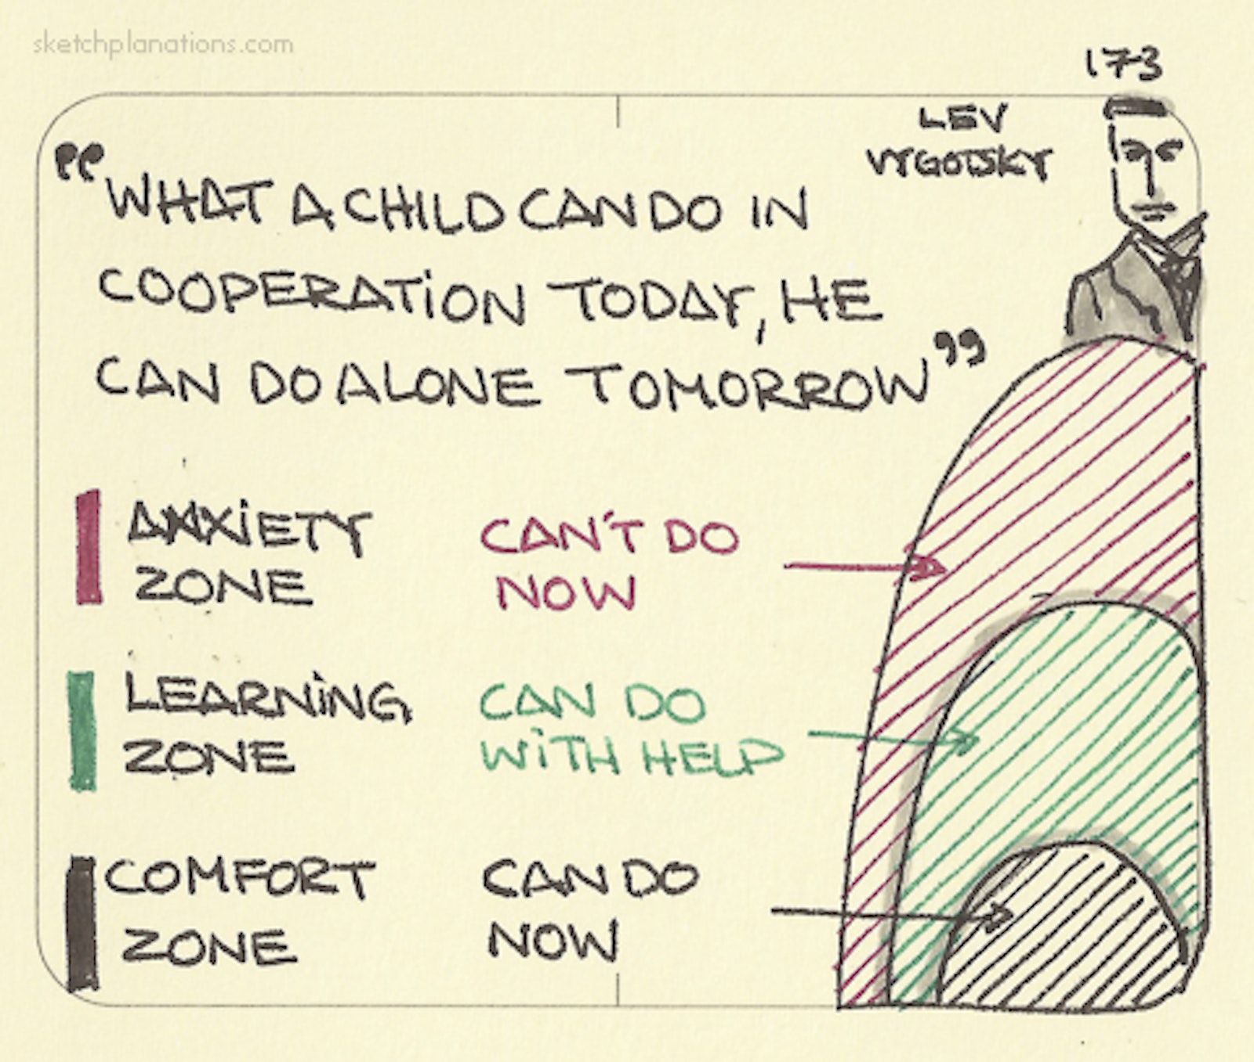
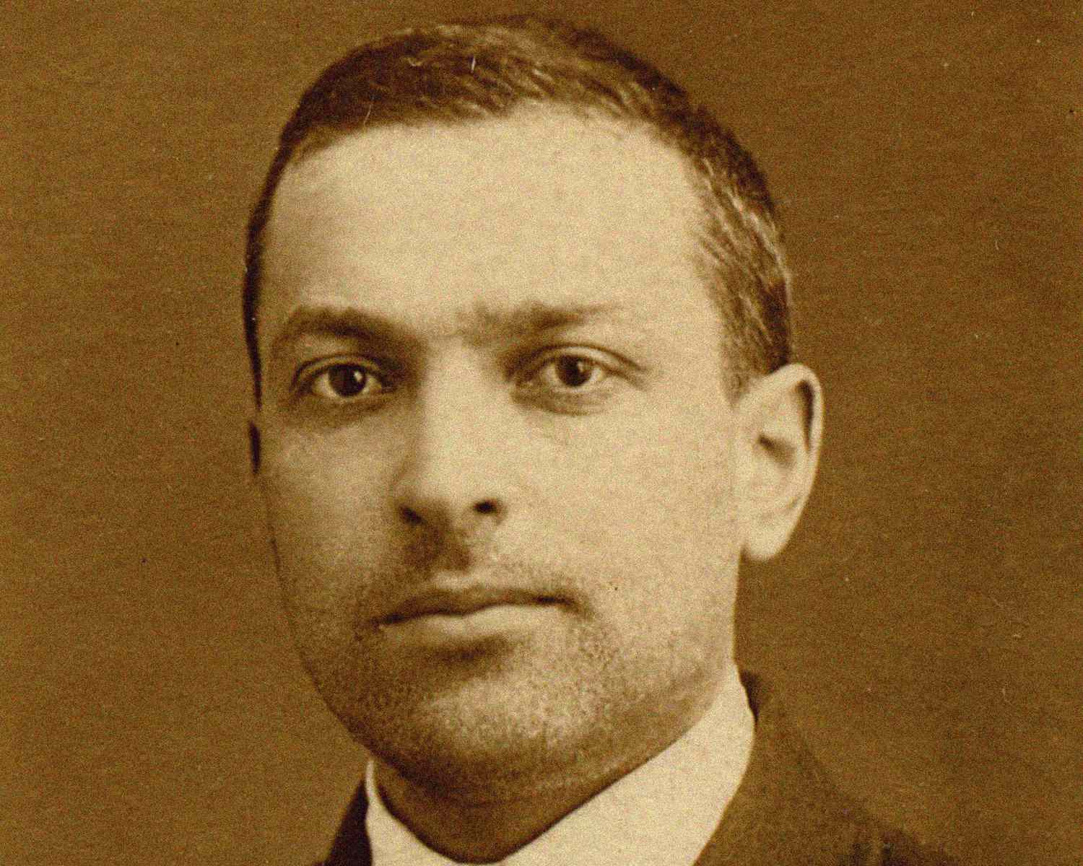
Insights from Educational Psychology
Lev Vygotsky
Zone of Proximal Development
Consideration: Where are your students when they begin your class? Where should they be by the end of your class?

Slide 14
Back to the example:
What should your students know or be able to do by the end of your class?
Understand multiplication…
Explore divergent philosophies...
Be able to express themselves….

Slide 15
All about that Verb!
Understand multiplication…
Explore divergent philosophies...
Be able to express themselves….
How will you know that they understand?
How will you document that they have explored?
What will you have your students do to express?
POINT: You need assessable verbs!

Slide 16
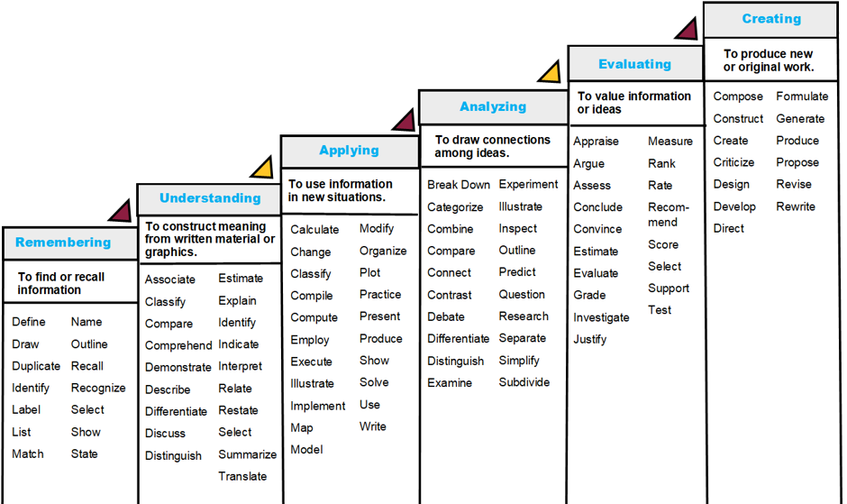
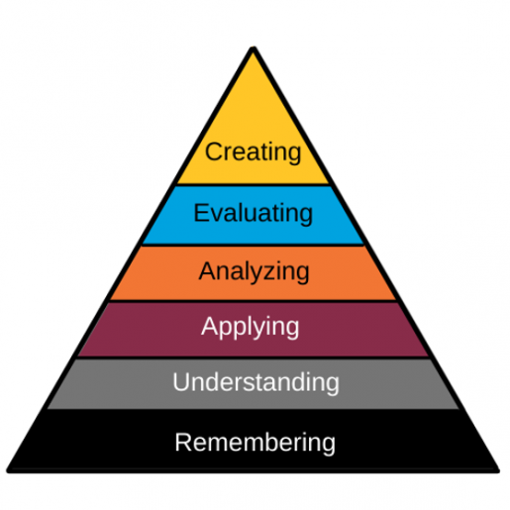
Insights from Educational Psychology
Benjamin Bloom
(revised 2001)

Slide 17
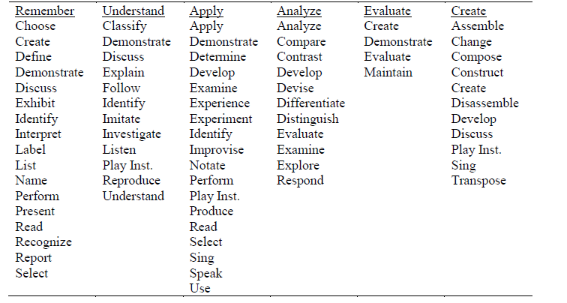
Artsy verbs in Bloom’s Taxonomy Context
Compiled by Eric E. Branscome and Cody Robinson
Full article available at http://www-usr.rider.edu/%7Evrme/v30n1/index.htm

Slide 18
The Final Piece: Assessment
What should your students know or be able to do by the end of your class?
COUNT!!!

Slide 19
The Final Piece: Assessment
What should your students know or be able to do by the end of your class?
COUNT!!!
Understand multiplication… (better!)

Slide 20
The Final Piece: Assessment
What should your students know or be able to do by the end of your class?
COUNT!!!
Understand multiplication… (better!)
Calculate multiplication equations…. (even better, but what’s still missing?)

Slide 21
The Final Piece: Assessment
What should your students know or be able to do by the end of your class?
COUNT!!!
Understand multiplication equations… (better!)
Calculate multiplication equations…. (even better, but what’s still missing?)
Students will calculate multiplication equations of 2-digit numbers by hand with 90% accuracy.
A = Audience (the student will)
B = Behavior (verb – should be assessable or measurable)
C = Condition (how the verb will be fulfilled / what students will use)
D = Degree (the specific target or assessment criteria)

Slide 22
Qualitative Assessment in a Quantitative World (when we can’t …with 90% accuracy)
Students will sing La Traviata with 90% accuracy
Students will jog a mile with 90% accuracy
Students will write a haiku with 90% accuracy
Students will analyze Monet’s Water Lily Pond with 90% accuracy
Students will accurately choreograph a dance 3 out of 4 tries
POINT: In your own content area, how can you change the D in the ABCD model?

Slide 23
Assessment Verbiage
Students will perform with 90% accuracy
Perform what? (VERB)
Perform it on what or using what? (CONDITION)
Perform it how well? (DEGREE)

Slide 24
Assessment Verbiage
Students will perform with 90% accuracy?
Instead:
Instrumental: Students will perform an F major scale in quarter notes at  = 120 bpm with correct fingerings.
Vocal: Students will sing a major scale with accurate solfege syllable and hand sign both ascending and descending.
YES, there are so many other things to assess, but what is the specific objective of this exercise?

Slide 25
Assessment Verbiage
Students will discuss music of their favorite musical genres.

Slide 26
Assessment Verbiage
Students will discuss music their favorite musical genres.
Instead:
Students will describe their favorite musical genres using appropriate musical vocabulary in the correct context.
Students will compare and contrast musical genres using the elements of music in the appropriate context.

Slide 27
Assessment Verbiage
Students will create a melody.
Before we move on, go ahead and dissect this one!
How will you evaluate this? (see next slide)

Slide 28
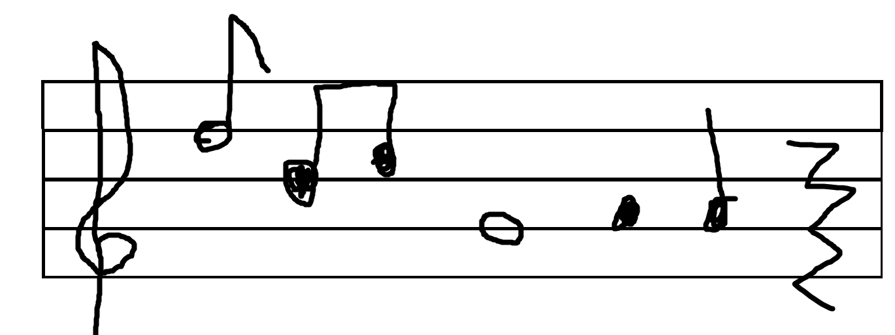
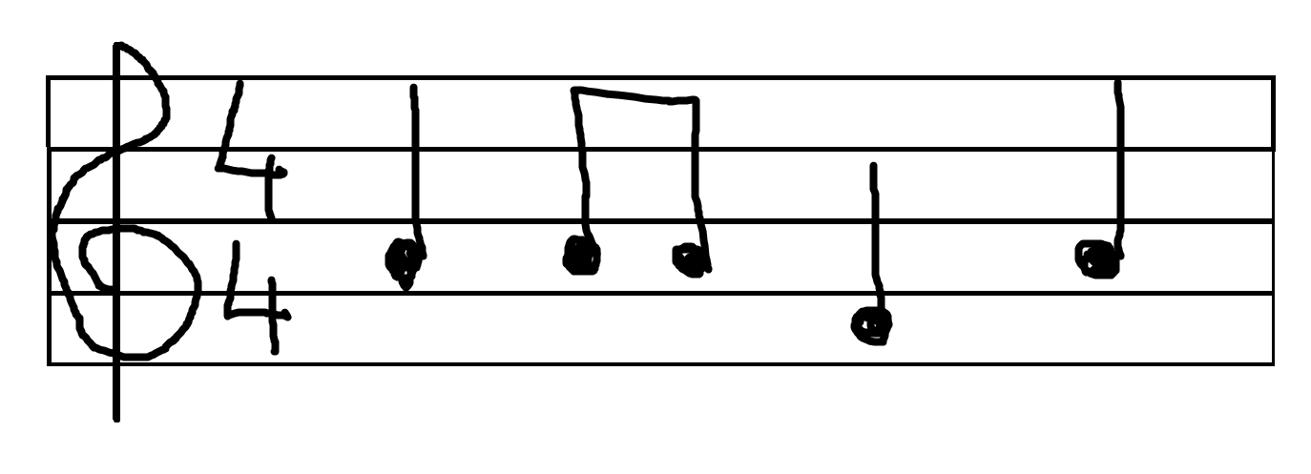
Student 1 submits this
Student 2 submits this
Student 3 submits this

Slide 29
Qualitative Assessment: Let’s Rubricize!
When you plan the assignment, begin with the end in mind.
By what criteria will you assess it?

Slide 30
From the musical example….
Starting point: Students will create a melody.
Ending point: Students will create a four-measure pentatonic melody in common time using quarter and 8th notes in standard notation.

Slide 31
From the musical example….
Starting point: Students will create a melody.
Ending point: Students will create a {four-measure} {pentatonic} melody {in common time} {using quarter and 8th notes} {in standard notation}.

Slide 32
From the musical example…
Students will create a four-measure pentatonic melody in common time using quarter and 8th notes in standard notation.

Slide 33
To rubricize….
Select your criteria
Select your levels (points)
Common verbiage / levels:
Always / Usually / Sometimes / Rarely / Never
All / Most / Some / Few / None
Resources:
D2L Rubrics
Rcampus Rubric Gallery www.rcampus.com

Slide 34
Now you can Quantify the Qualitative!
NO: Students will write a melody with 80% accuracy.
YES: Students will create a four-measure pentatonic melody in common time using quarter and 8th notes in standard notation.
Reporting to IER: 80% or more of students will earn Exceeds Expectations on the Melody Assignment
Even Better:
80% or more of students will earn exceeds expectations on the pentatonic domain of the Melody Assignment rubric
80% or more of students will earn exceeds expectations on the time-signature domain of the Melody Assignment rubric

Slide 35
Conclusion
Identify where your classes fit in the ‘funnel’ of your department.
Use a curriculum matrix to identify prescribed standards for your classes.
Write and implement assessable student learning outcomes for your courses.
Document assessment results for your department’s assessment processes.
(if needed) quantify the qualitative aspects of your curriculum.
Understand that you can’t write a melody with 90% accuracy!
Eric Branscome: eric.Branscome@tamuc.edu

Slide 36
Time for Questions!

