Slide 1
Accreditation:
Quality Assurance through Peer Review
Elizabeth Vogt
AVP Accreditation
University of North Texas

Slide 2
Agenda
Accreditation – A very brief history
Why accreditation is important
Where we often go wrong
QEP
Success and lessons learned at UNT
Recommendations

Slide 3
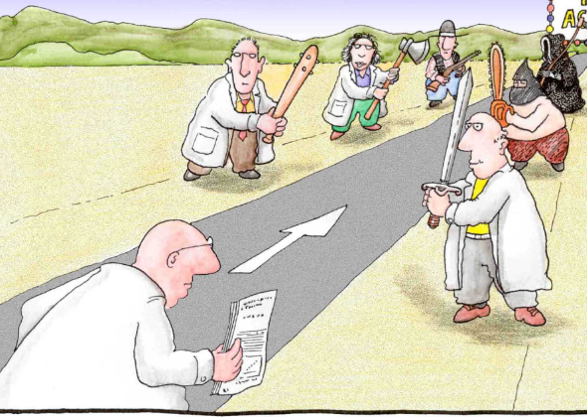
Brief History Accreditation
Accreditation through the peer review process has been around for over 100 years
1965 Higher Education Act: Accrediting agencies reviewed every 5 years by the federal government
Eaton, J. S. (2018). Fifty Years as an Opportunity—for Change Magazine, Accreditation, and the Rest of Us. Change: The Magazine of Higher Learning, 50(3-4), 124-127
Notes:
Peer driven until the GI bill

Slide 4
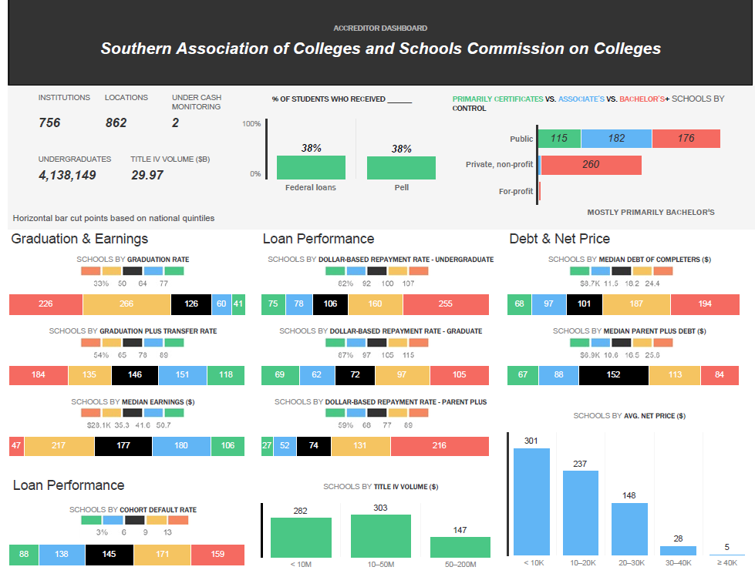
Accrediting Accreditors: National Advisory Committee on Institutional Quality and Integrity (NACIQI)
Notes:
This shows what the federal government is interested in now
NACIQI was responsible for terminating recognition of the largest for-profit agency- Accrediting Council for Independent Colleges and Schools (ACICS)

Slide 5
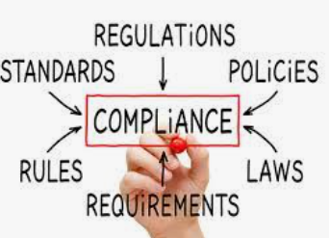
Accreditation Now
Extensive government oversight of accreditation
More than 200 billion in higher education (HE) funding
Rising cost of HE
Public Accountability
Accrediting agencies act as a buffer
Attempt to keep the focus on quality and improvement
Eaton, J. S. (2018). Fifty Years as an Opportunity—for Change Magazine, Accreditation, and the Rest of Us. Change: The Magazine of Higher Learning, 50(3-4), 124-127
Notes:
Federal gov says education is a state and local responsibility- and yet…

Slide 6
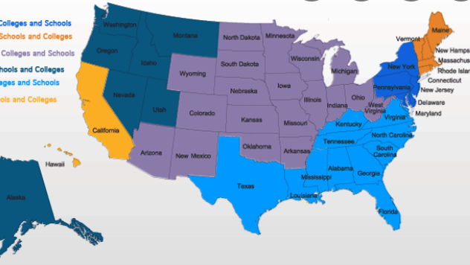
Accreditation provides:
A public assurance of quality
An assurance that our degrees meet standards and have value in the marketplace
Access to federal financial aid
Opportunities for students to transfer credit
Assurance of fiscal responsibility
Assurance that we are investing in continuous quality improvement
Notes:
Why is it important?

Slide 7
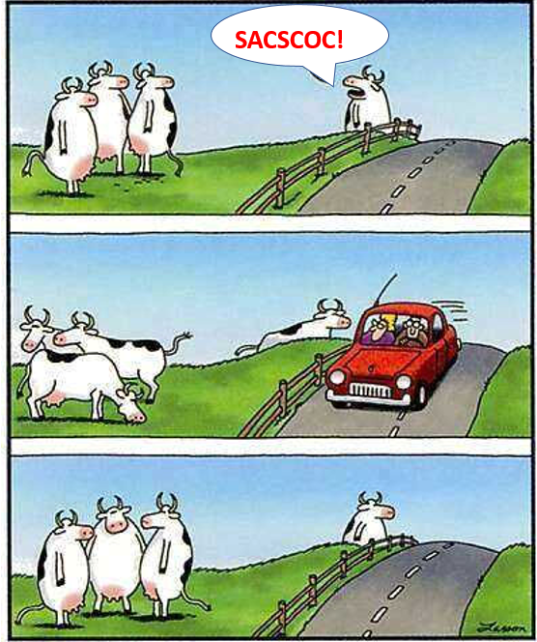
Where do institutions go wrong?
By not addressing every part of every standard
Lack of proof for an ongoing systematic process for compliance
A single year’s worth of evidence will not show an ongoing process
By not providing enough detail-Proof = Evidence
Reviewers
Notes:
Annual reports are the bread and butter of accreditation. The focus is improvement. It is difficult to show improvement without 3 years
Policies are great, but you cannot just show you policy. Describe how the policy works. Provide evidence that the policy was implemented.
For reviews of administrators- 3 years of evaluations.

Slide 9
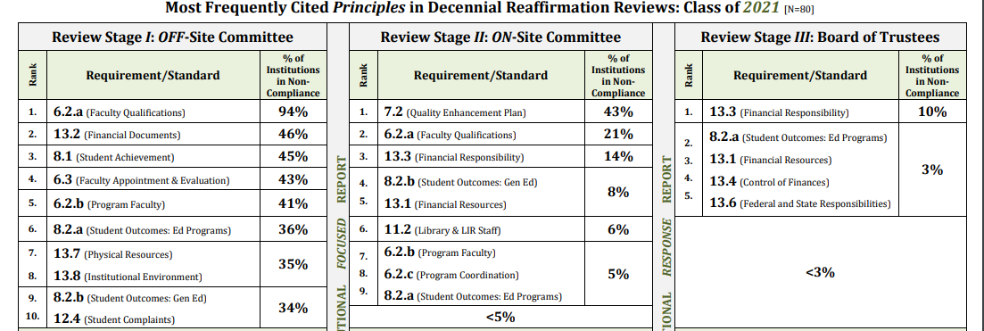
Notes:
Offsite- An average of 14 or 15 OOC. The average after the on-site is <2, but most are okay at this point.

Slide 10
Derived from an institution’s ongoing comprehensive planning and evaluation process
Focus is on an issue the institution considers important to improving student learning and/or student success
Must have broad-based support
Should impact a significant student population
Must have resources committed
Must have an assessment plan
Use the SACSCOC suggested format: Page 40-
https://sacscoc.org/app/uploads/2020/03/Handbook-for-Institutions-Seeking-Reaffirmation.pdf
7.2- Quality Enhancement Plan (QEP)
Notes:
If you do great at the off-site, the main focus, besides checking boxes, will be your QEP. The last time we did a qep it was more of a bottom up; now it can be top down. Now it can be something we are already doing- doesn’t have to be “new”
What is important to this institution? What have you identified?
They will look at your overall planning process in 7.1. Document the process

Slide 11
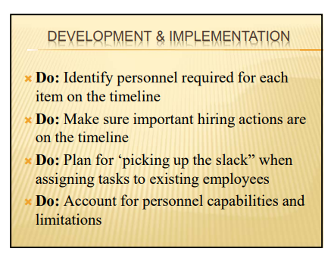
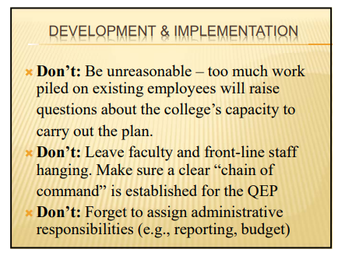
DO: Submit 7.2 information to the off-site for review!
DO: Research potential candidates to be the QEP lead evaluator* (Due 3+ months before visit)
https://sacscoc.org/app/uploads/2020/01/Larry-Earvin-and-Charles-Taylor_Submitting-the-QEP-and-Preparing-for-the-Committee-Visit_Presentation.pdf
Notes:
Off-Site Reaffirmation Committee to provide an opinion as to whether the intended QEP appears to offer a reasonable attempt to comply.

Slide 12
Our Success at UNT
Lessons Learned
Annual process for outcomes assessment
Biannual process for general education (Texas Core)
Teamwork
Use headings liberally
Leave time to review
Highlight important areas in your report
Judicious use of consultants

Slide 13
Deadlines
SLO reporting- Move up the due date!
Have a draft of your QEP (7.2) for the off-site review
Be vocal about your QEP- Ensure all constituents know about it
Be detailed in your faculty credentials
Notes:
If you have draft deadlines for the report sections, stick to them! Move them up if you have not allowed time (at least 2 weeks) to check every link in the report. Complete your outcomes assessment reporting early! Move that deadline to mid may for this year.

Slide 14
Questions
Elizabeth.Vogt@unt.edu

